Slide 1






Session 3-1
Reduction of Reaction Mechanisms I
Tibor Nagy
HUN-REN Research Centre for Natural Sciences, Budapest, Hungary
CYPHER − COST Action CA22151
Training school on the analysis, uncertainty quantification, validation,optimization and reduction of combustion kinetic mechanisms
September 2-5, 2025 − Budapest, Hungary

Slide 2

Analysis of kinetic reaction mechanisms
Tamás Turányi and Alison S. Tomlin:
Analysis of kinetic reaction mechanisms
Springer, 2014
(with 1025 references)

Slide 3
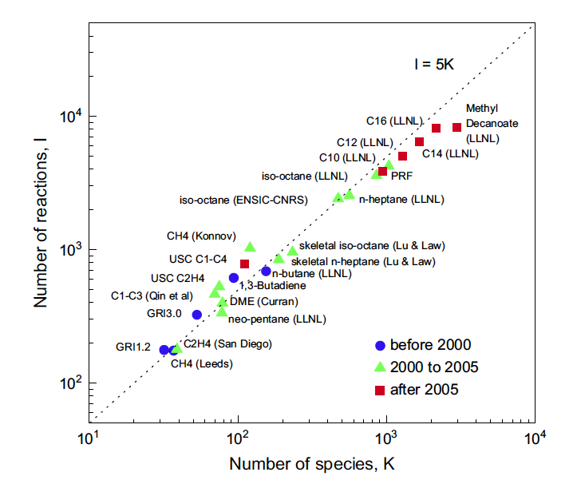
Reaction mechanisms are getting larger
Increasing mechanistic and kinetic knowledge
New systems explored biofuels, synthetic fuels and blends, N/S/P/metals
Rate rules
automatic construction
(RMG, MAMOX++)
Huge models
    Gasoline fuels
    (bio)diesel combustion
    PAH, soot formation
Faster algorithms and computers
Still not fast enough for CFD
T. Lu, C. K. Law: Toward accommodating realistic fuel chemistry in large-scale
computations. Prog. Energ. Combust. Sci., 35,192-215 (2009)

Slide 4


Need for mechanism reduction
1. Spatially homogeneous system
ordinary differential equations (ODEs)
large mechanism – expensive evaluation of the right-hand side
multiple timescales (stiff systems)
⇒ require special integration techniques (stiff ODE solvers)
the largest mechanisms can be integrated within minutes on a single core
A simplified model helps understand the chemistry and accelerate a large number of simulations (e.g. global sensitivity/uncertainty analysis, optimization (RAPOD)).
$$\frac{dc(t)}{dt}=f(c,T,p,…)$$
2. Spatially inhomogeneous system
partial differential equations (PDEs)
solved by spatial discretization and operator splitting (chemistry/transport)
chemistry is solved at each timestep for large number of spatial units.
Most of the computer time (e.g. 99%) is spent on chemistry.
practical limitation in mechanism size for 3D problems ~ 50 species
Mechanism reduction accelerates the simulations,
and in many cases, it makes them feasible !
$$\frac{∂c(r,t)}{∂t}=f(c\left(r,t\right),T\left(r\right),p\left(r\right),v\left(r\right),…)$$

Slide 5
Classification of mechanism reduction methods
Mechanism reduction
provides a mathematically simplified, and thus computationally
more efficient description of chemical kinetics.
I. Methods without considering time-scale separation
1. Skeletal reduction: elimination of redundant species and reactions
⇒ a smaller, usually less stiff ODE with mass-action kinetics
2. Lumping (see later): Combines similar species&reactions into lumped ones.
II. Methods based on time-scale separation (see later)
1. Simplification of the mechanisms using methods QSSA, PEA, CSP
⇒ ODEs for slow variables, and algebraic equations for fast variables
2. Slow manifold methods
III. Tabulated and fitted models (see later)
The various methods are often combined, and
some methods can be applied repeatedly for better results !
According to the way of application:
  on-the-fly: - simplifies the model during simulation, based on local conditions - requires modifications of the integrator code (DAC DRG,Zero-RK)
  static (a priori):- makes a single model for later use in large-scale simulations
  [OUR FOCUS] - skeletal/lumped models can be used just like the full model
5
Notes:
Computational Singular Perturbation (CSP)
Quasi-steady state approximation (QSSA)
Partial-equilibrium approximation (PEA)

Slide 6
Possibility for skeletal reduction
Mechanisms usually contain redundant reactions/species
Developers try to remain on the safe side by adding most of the known species and reactions, some of which always turn out to be irrelevant at most of the conditions.
Application to a narrower range of conditions
The domain of applicability (T, p, c or ϕ range) is usually smaller than the original domain of validity of the original reaction mechanism.
Only some modelling results are of interest
For specific studies the reproduction of concentrations of only some species or some features (ignition delay, burning velocity, emissions) is of interest.
Some accuracy can be sacrificed
It is acceptable if the simulation results differ by no more than the inherent uncertainty of the full mechanism, as assessed by validation against experiments.
For inhomogeneous systems ~ a series of homogeneous systems
Chemical conditions in 2D-3D inhomogeneous system can be covered by those in simpler 0D-1D systems (e.g. plug-flow reactors, jet-stirred reactors, laminar flames).
Various time scales are present (see later)

Slide 7
Combustion kinetic model uncertainties
Even the original, detailed mechanisms are not „the real ones” !
They are rarely complete or fully general
Many elementary steps are omitted due to lack of mechanistic or kinetic knowledge, or simply to keep the mechanism at a tractable size.
Analytical and theoretical methods often fail to identify all species/steps.
They are typically developed for a specific domain of conditions (c, p, T).
They contain numerous uncertain parameters
rate coefficients: Well-studied small radical reactions (e.g. H+O₂) ±20-50%
- High-level theory: factor of ~2–3 uncertainty for small, simple reactions
- Larger hydrocarbons, barrierless or pressure-dependent reactions: ~×10 or more
thermodynamic data: ΔH~1-2kcal/mol for small molecules, rather uncertain for larger, floppy molecules
transport parameters: ~×2, but worse for large, asymmetric molecules
They are based on physical approximations
Ideal gas law (pV=nRT) can fail at high-pressure and when strong intermolecular forces are present.
Local thermal equilibrium approximation (→ thermal rate coefficients) reaction products get thermalized before they react again (e.g., not for prompt reactions)

Slide 8
Skeletal reduction methods
There are over 50 methods for systematic skeletal reduction.
We will focus on the most influential and widely adopted approaches.
Species removal methods
CM (1990) Connectivity Method
DRG (2005) Directed Relation Graph
DRGASA (2006) DRG-aided sensitivity analysis
DRGEP (2007) DRG with error propagation
PFA (2010) Path Flux Analysis
SEM-CM (2009) CM with Simulation Error Minimization
GPS (2016) Global Pathway Selection – also for reaction removal!
Reaction removal methods
ROPA (197x) Rate of Production Analysis
PCAS (1985) Principal Component Analysis of the Sensitivity Matrix (S)
PCAF (1989) PCA of the Rate Sensitivity Matrix (F)
SEM-PCAF (2009) PCAF with simulation error minimization
New methods are published every year, but none have significantly
outperformed these and become widely adopted.

Slide 9
Basic notions in skeletal mechanism reduction
Scenarios: a representative conditions covering the domain of interest
Target quantities: accurate calculation of them is the aim of modelling
Targets - concentration of important species
  major reactants, products, pollutants
  some important intermediates (OH,etc), radicals in chain branching, etc
Targets - important combustion features
  ignition delay time
  laminar flame speed
  extinction limits (in JSR and laminar flames)
Necessary species and reactions: those needed for the accurate calculation of targets (includes important species)
Redundant species and reactions: neither important and nor necessary, thus can be eliminated from the mechanisms
Simulation error: the deviation of reduced model’s predictions
from those of the full model
T. Turányi: Reduction of large reaction mechanisms, New J.Chem., 14, 795-803 (1990)
Notes:
. Extinction Range
Definition: The set of conditions (temperature, pressure, strain rate, or flow velocity) under which a flame cannot propagate and is extinguished.
In premixed flames, the extinction strain rate or critical flow velocity defines the boundary.
The extinction range depends not only on mixture composition but also on flame stretch, heat loss, and transport properties.

Slide 10
Removal of redundant species
Identification of necessary species
”Trial and error” based removal approach
Species and/or reactions are deleted one-by-one and the effect on targets is investigated with simulations. Not effective enough as:
Some species can be eliminated only in groups e.g. those participating in fast pre-equilibrium reactions.
Elimination of species groups ⇒ too many combinations
Many expensive simulation for large mechanisms (i.e., N_{species} > 100).
”Kinetic connectivity” based building approach
Using a suitable measure for ”kinetic connectivity” of each species to the group of already selected species (initially the important ones) is determined.
Strongly connected species are selected.
Steps 1-2 are repeated until the not yet selected species are all weakly linked to the group of necessary species.
If the target is not a concentration then we should select species which is strongly connected to the target combustion feature.

Slide 11
start
important species = initally selected
not yet selected species
11

Slide 12
iteration 1
important species
necessary species
not yet selected species

Slide 13
iteration 2
important species
necessary species
not yet selected species

Slide 14
iteration 3
important species
necessary species
not yet selected species

Slide 15
iteration 4
important species
necessary species
not yet selected species

Slide 16
iteration 5
important species
necessary species
redundant species

Slide 17
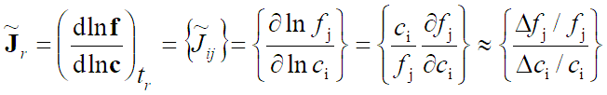
Species removal 1: Connectivity Method (CM)
Kinetic connectivity of a species i to species j (at a given state):
is measured by the J_{ij} element of the lognormalized Jacobian at a given time (t_{r}):
= the effect of species i concentration on the production rate of species j.
Kinetic connectivity of species i to the group of selected species:
List of selected species.
Species ranked according to their connectivity (B_{i}) to them:
Not yet selected species with largest B_{i} values are selected.
Repeat procedure until all not selected species are weakly connected (gap in B)
Carried out at each state and the lists of necessary species are unified.
Reduced models must be validated, can be done during mechanism building!
Works well for small models, but no gap appears in B values for large models (N_{spec}>100). B threshold is not related to model accuracy.
The special role of important species diminishes with every step.
T. Turányi: Reduction of large reaction mechanisms, New J.Chem., 14, 795-803 (1990)

Slide 18
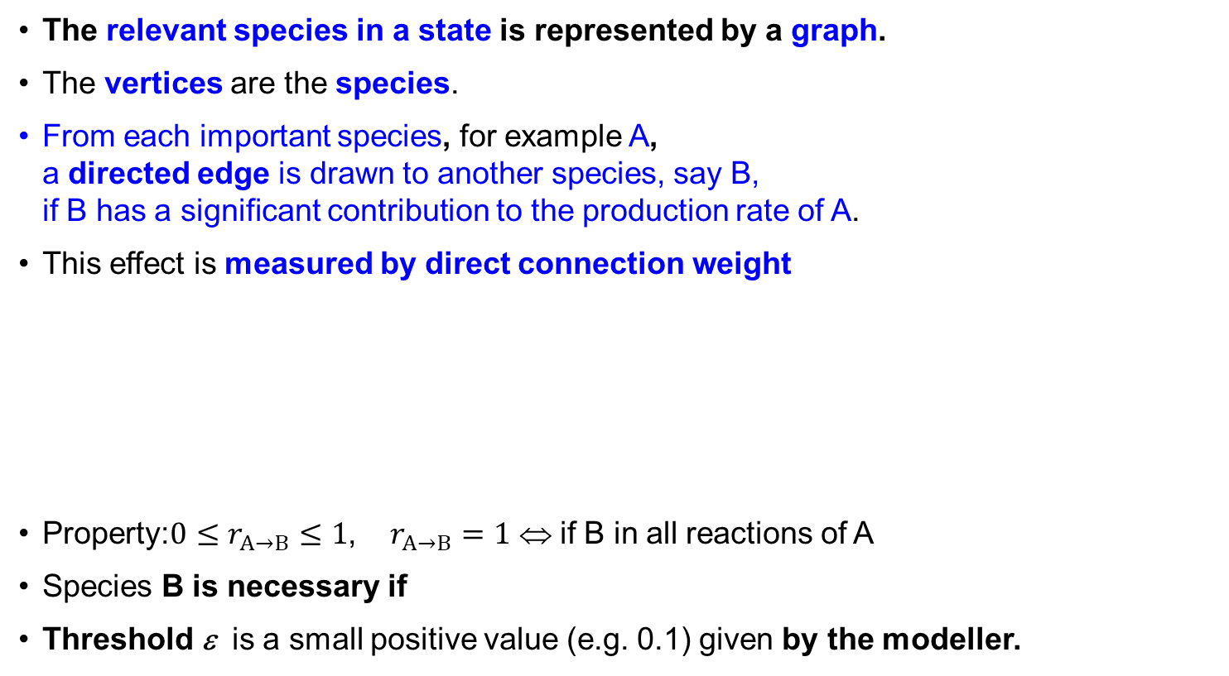
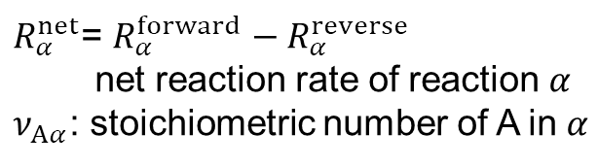
Species Removal 2:
Directed Relation Graph (DRG) Method
The relevant species in a state is represented by a graph.
The vertices are the species.
From each important species, for example A,
a directed edge is drawn to another species, say B,
if B has a significant contribution to the production rate of A.
This effect is measured by direct connection weight
Property:$0≤r_{A→B}≤1$, $r_{A→B}=1$ ⇔ if B in all reactions of A
Species B is necessary if
Threshold ε is a small positive value (e.g. 0.1) given by the modeller.
A
B
C
$R_{α}^{net}$= $R_{α}^{forward}−R_{α}^{reverse}$
net reaction rate of reaction $α$
$ν_{Aα}$: stoichiometric number of A in $α$
T. Lu, C. K. Law: A directed relation graph method for mechanism reduction.
Proc. Comb. Inst., 30 (2005) 1333–1341.

Slide 19
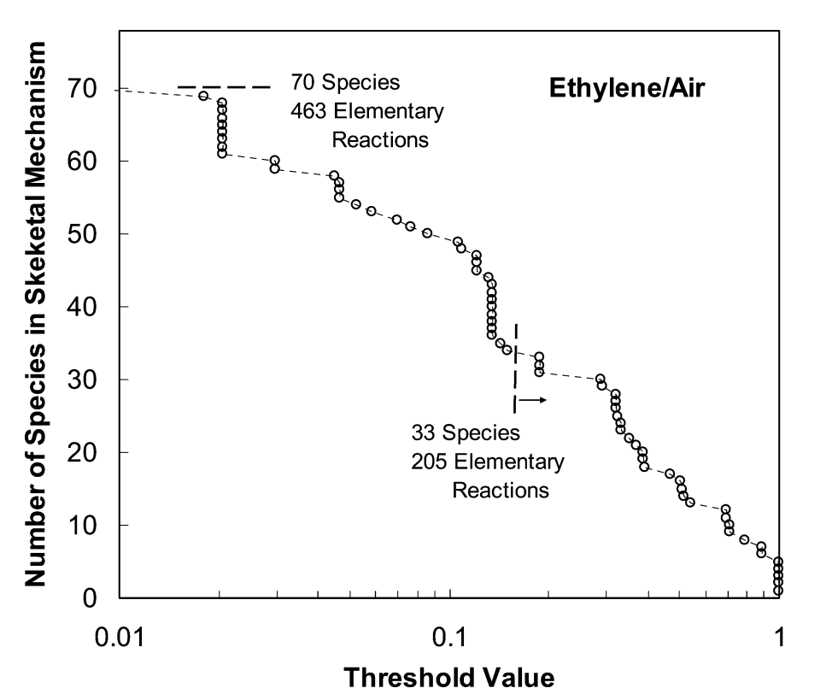
Species Removal 2:
Directed Relation Graph (DRG) Method
Selection procedure of necessary species
Iteratively directed vertices are drawn from each newly selected species (X) to other species (Y) if r_{X→Y} >ε
until no more vertices can be drawn.
A species is necessary if there is a directed path
from any target species to it.
Importance of species C to the production of the target species (T_{i}) (critical value for selection)
necessary if and redundant if
Repeated at all selected states.
Smaller ε gives larger reduced mechanism.
A
B
C
Lu&Law: Proc.Comb.Inst.(2005)

Slide 20
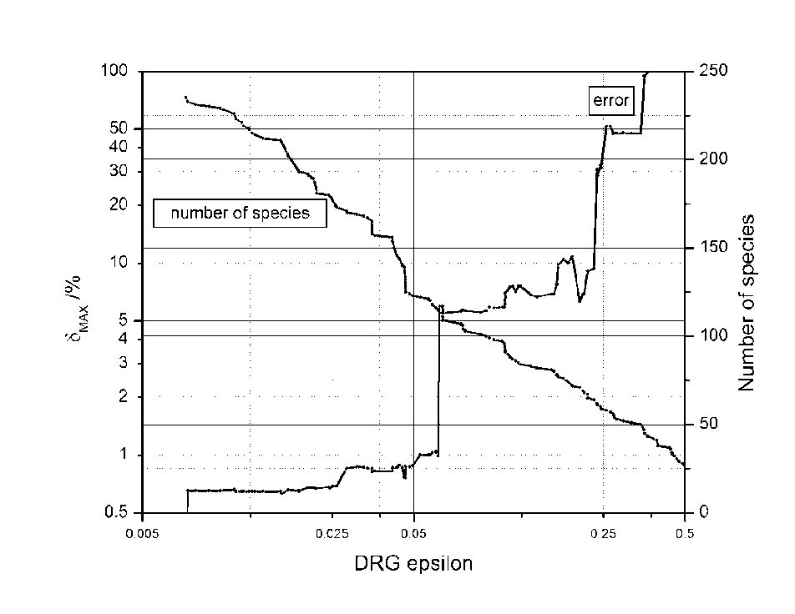
Species Removal 2:
Directed Relation Graph (DRG) Method
"DRG with restart” method
reapplying DRG to a DRG-reduced mechanism (changed fluxes!)
Often a smaller reduced mechanism can be obtained at a given accuracy.
DRG method is simple&fast
⇒ widespread method
But, it is suboptimal because
Every selected species becomes
equally important.
Simulation error does not decrease
monotonically and often stagnates
with decreasing ε
⇒there might a smaller,more accurate mech!
T.Nagy, T.Turányi Combust. Flame. (2009)
T. Lu, C. K. Law: Linear time reduction of large kinetic mechanisms with directed relation graph: n-heptane and iso-octane. Combust. Flame, 144 (2006) 24–36.

Slide 21
Species Removal 3:
DRG-Aided Sensitivity Analysis (DRGASA) Method
DRG-reduced mechanisms still contain redudant species
which have only minor effect on the targets species or features
even though they might have more significant effect on other species
Identifying such redundant species
A range of species that were selected with relatively low importance,
e.g. 0.2 = ε ≤ ε_{X}^{DRG} ≤ 0.4, might not be necessary for accurate reduction.
Their importance is reassessed by individually eliminating them and calculating the resulting error (~ sensitivity-analysis).
The species whose removal causes the smallest error increase is eliminated.
This process is repeated until the error becomes unacceptably large.
X.L. Zheng, T.F. Lu, C.K. Law: Experimental counterflow ignition temperatures
and reaction mechanisms of 1,3-butadiene, Proc. Comb. Inst., 31 (2007) 367–375

Slide 22
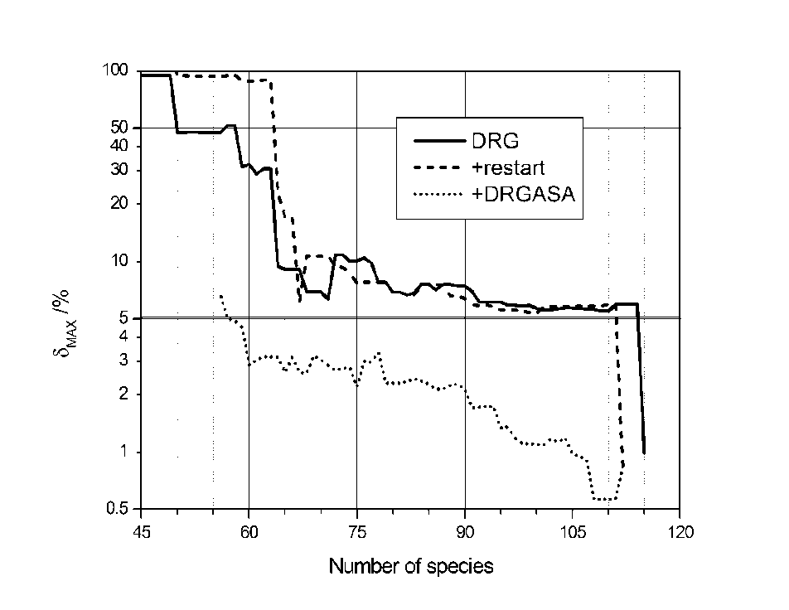
DRG vs. DRG with restart vs. DRGASA methods
Case study: reduction of a methane partial oxidation mechanism
full mechanism: 6874 reaction, 345 species
aim: 5% maximum error in the concentration profile of 12 target species
DRG with restart
slighlty better results with repeated application
115 → 112 species
DRGASA
started from a mechanism with 1% accuracy
much smaller mechanism
at 5% error
T. Nagy, T. Turányi: Reduction of very large reaction mechanisms using methods based on simulation error minimization, Combust. Flame, 156 (2009) 417–428

Slide 23
Species Removal 4: Directed Relation Graph
with Error Propagation (DRGEP) method
A
DRGEP definition of the weight of directed edges (A→B)
B
C
It measures the ratio of sum of the production rates of species A from reactions involving B to the maximum of the total formation or destruction rates of A.
Importance of C to the target species (T_{i}) (critical value for selection)
Species C is necessary if and redundant if
Better than DRG, as selected species don’t become equally important.
P. Pepiot-Desjardins, H. Pitsch: An efficient error-propagation-based reduction method for
large chemical kinetic mechanisms, Combust. Flame, 154, (2008) 67-81

Slide 24
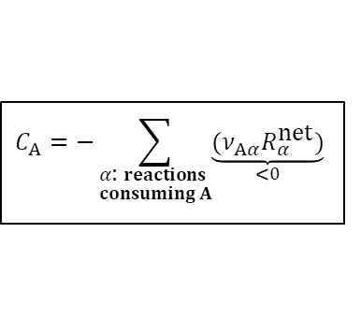
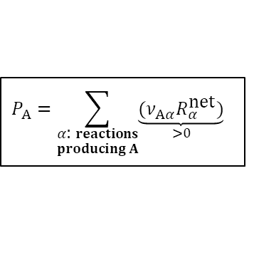
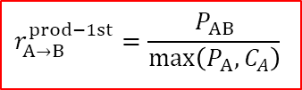
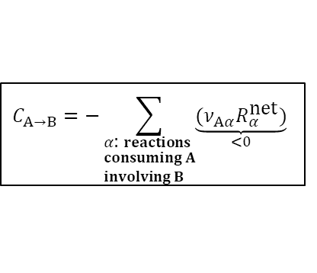
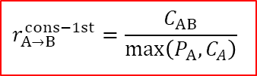
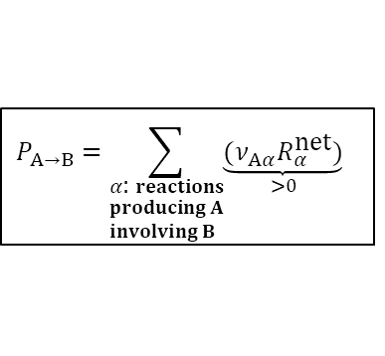
Species Removal 5: Path Flux Analysis (PFA)
Production (P_{A}) and consumption (C_{A}) fluxes of species A:
Production (P_{AB}) and consumption (C_{AB}) fluxes of species A via species B
1st and 2nd generation flux ratios, separately for production and consumption:
Total effect:
$$P_{A}=\sum_{\begin{aligned}&α\text{: }reactions \\ &producing A\end{aligned}}{\underset{>0}{\underbrace{(ν_{Aα}R_{α}^{\text{net}})}}}$$
$$C_{A}=−\sum_{\begin{aligned}&α\text{: }reactions \\ &consuming A\end{aligned}}{\underset{<0}{\underbrace{(ν_{Aα}R_{α}^{\text{net}})}}}$$
$$P_{A→B}=\sum_{\begin{aligned}&α\text{: }reactions \\ &producing A \\ &involving B\end{aligned}}{\underset{>0}{\underbrace{(ν_{Aα}R_{α}^{\text{net}})}}}$$
$$C_{A→B}=−\sum_{\begin{aligned}&α\text{: }reactions \\ &consuming A \\ &involving B\end{aligned}}{\underset{<0}{\underbrace{(ν_{Aα}R_{α}^{\text{net}})}}}$$
$$r_{A{→}B}^{prod−1st}=\frac{P_{AB}}{\max\left(P_{A},C_{A}\right)}$$
$$r_{A{→}B}^{cons−1st}=\frac{C_{AB}}{\max\left(P_{A},C_{A}\right)}$$
Starting from the important species, using relation the set of further necessary species are identified. More effective than DRGEP.
W. T. Sun, Z. Chen, X. L. Gou, Y. G. Ju: A path flux analysis method for the reduction of detailed chemical kinetic mechanisms Combust. Flame 157 (2010) 1298-1307

Slide 25
Common features of the
CM/DRG/DRGEP/PFA methods
INPUT – list of conditions and required accuracy
Take multiple 0D-1D reactors to cover the conditions in your real system
regarding temperature, pressure, equivalence ratio, dilution, heat loss rate, etc.
INPUT – list of initially selected, ”important species”
always: fuel, oxidant, diluents, H-chemistry (10 species), products H₂O,CO, CO₂
for global targets (Ignition Delay Time, Laminar Burning Velocity)
IDT: chemistry of low-T chain branching (RO₂·,·QO₂H,·O₂QO₂H, KHP)
LBV: CH_{x}, C₂H_{x} species (rich, sooting), species in heat releasing reactions
INPUT – a threshold value
controls the mechanism size, but not directly related to the simulation error, especially when targets are global properties (e.g. ignition delay time).
Only few reduced mechanisms are produced and tested in simulations.
However, homogeneous modelling with small mechanisms is very fast !
Concept of ”Simulation Error Minimization (SEM)”
During the skeletal mechanism construction, investigate several additions of strongly connected species by simulations and select those for building which reduce the simulation error the most effectively!

Slide 26
Improving on the Connectivity Method (CM)
Assume a mechanism: 1. A + B → C c_{A,0}, c_{E,0} >0=c_{B,0}, c_{C,0}, c_{D,0}
A is important 2. E → D → B
Issue of incomplete reaction selection
B strongly affects the rate of A (J_{BA}² large)⇒ B is selected in the first step
However, J_{CA}=0, thus C is not selected ! ⇒ ”No reaction is selected”
⇒ Building should be done not by species, but by complementary sets:
a single or a group of not yet selected species, whose inclusion into
the mechanism results in the selection of at least one additional reaction.
e.g. {B,C} should be selected together
Issue of missing formation route
There is no forming route to species B and C ! ⇒ B, C are ”dead” species
⇒ Every selected species must have a formation path ⇒ living species:
  It has nonzero initial concentration or an inflow term (e.g. in PSR) or
  formation route in the reduced mechanism from such species
  e.g. {B,C,D,E} should be selected together
living mechanism: all of its species are living
These problems also occur in DRG, DRGEP and PFA methods.

Slide 27
Species Removal 5: Simulation error minimization connectivity method (SEM-CM)
1. Setting up the reduction
Define reactors and conditions, and run simulations with the full model.
Select representative states (p, T, x) from the solutions
Calculate log-normed Jacobians at these states.
Define important species to start model building.
Define targets the reduced model must match within the required accuracy.
2. Creating and ranking complementary sets
Selected species are deleted from the species of each not yet selected reactions.
Ranked according to their average strength of the direct link to the group of selected species is, which is characterized by C_{k} for complementary set k:
SEM-CM allows arbitrary combinations of complementary sets as well
(e.g. all 3 combinations of the top five highest ranked)

Slide 28

Species Removal 6: SEM-CM
3. Generation of several extended sets
extended set: selected species + complementary set
several complementary sets with similarly strong link (C_{k}) exist
depth level m: each complementary sets down to the m^{th} in the rankings are added separately, resulting in m extended sets.
4. Generation of living reduced mechanisms
Extended sets may contain dead species.
Find complementary sets of the forming reactions of dead species.
Rank these complementary sets:
Highest ranked complementary sets are added.
The procedure is repeated until the mechanism becomes living.
$${\tilde{J}}_{max,{i}j}^{2}(t_{k})=\max_{l:t_{l}≤t_{k}}{\tilde{J}}_{ij}^{2}(t_{l})$$
5. Simulations and building a database
All scenarios are simulated with the new reduced mechanisms.
Species lists and simulation errors of each model are stored in a database.

Slide 29
Species Removal 6: SEM-CM
1. Setting up the reduction problem
2. Creating and ranking complementary sets
3. Generation of several extended sets
4. Generation of living reduced mechanisms
5. Simulations and building a database
6. Take the next-largest mechanism (i.e., with one more
species) with the smallest error from database.
Is its error below the required threshold?
No
Yes
Finish

Slide 30
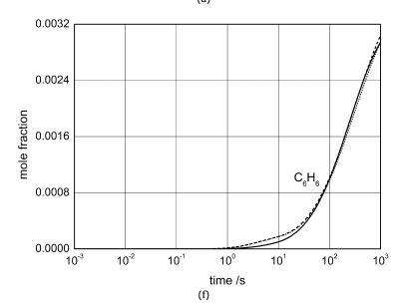
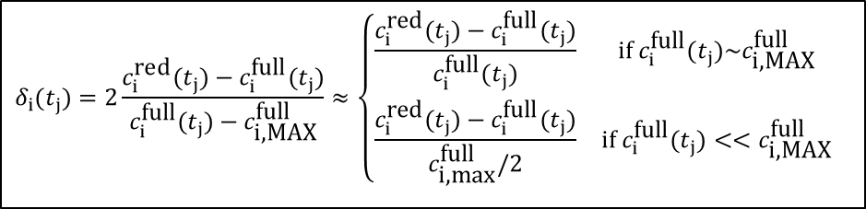
SEM case study 1: gas-phase chemistry in solid-oxide fuel cells (SOFC): partial oxidation of methane
Dean et al. mechanism: 345 species and 6874 irreversible reactions.
Reduction is needed for computer optimization of fuel cell geometry and operating conditions.
30 / 70 vol% methane / air, at T = 900°C, p =1 atm, isothermal and isobaric
12 important species: CH₄, N₂, O₂, H₂, H₂O, CH₂O, CO, CO₂,
C₂H₂, C₂H₄, C₂H₆, C₆H₆. (x_{max}> 0.001)
Aim: concentration error < 5% for 1000s simulation time
Mixed error of species i at time t_{j} :
Worst case error considering all times and species:
$$δ_{i}(t_{j})=2\frac{c_{i}^{\text{red}}(t_{j})−c_{i}^{\text{full}}(t_{j})}{c_{i}^{\text{full}}(t_{j})−c_{\text{i}\text{,}\text{MAX}}^{\text{full}}}≈\left\{\begin{matrix}\frac{c_{i}^{\text{red}}(t_{j})−c_{i}^{\text{full}}(t_{j})}{c_{i}^{\text{full}}(t_{j})} & \text{if} c_{i}^{\text{full}}(t_{j})\sim c_{\text{i}\text{,}\text{MAX}}^{\text{full}} \\ \frac{c_{i}^{\text{red}}(t_{j})−c_{i}^{\text{full}}(t_{j})}{c_{\text{i}\text{,}\text{max}}^{\text{full}}/2} & \text{if} c_{i}^{\text{full}}(t_{j})<<c_{\text{i}\text{,}\text{MAX}}^{\text{full}}\end{matrix} \right.$$
≈ relative error
≈ scaled absolute error

Slide 31
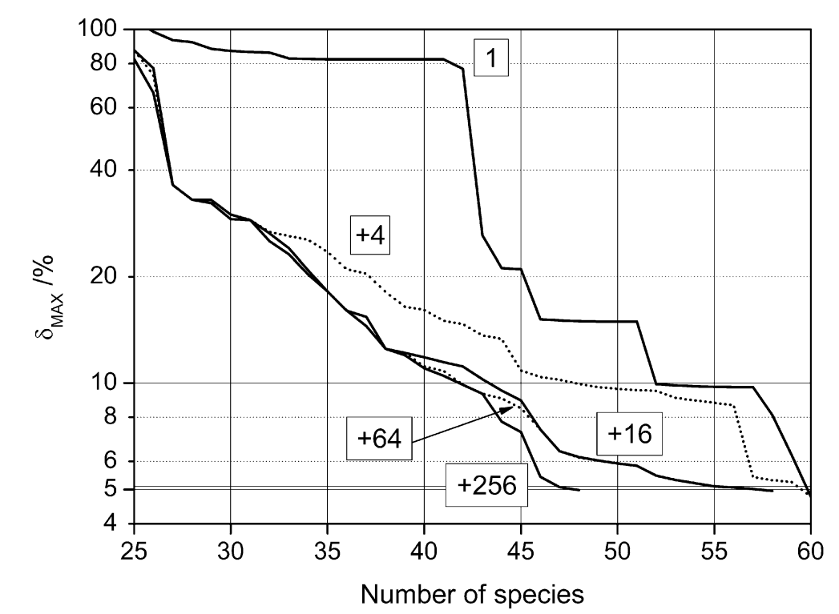
SEM case study 1: gas-phase chemistry in solid-oxide fuel cells (SOFC): partial oxidation of methane
Full mechanism:
345 species
Repeated application with increasing depth levels of 1,4,16, 64, 256 using previously stored databases ⇒ cannot worsen!

Slide 32
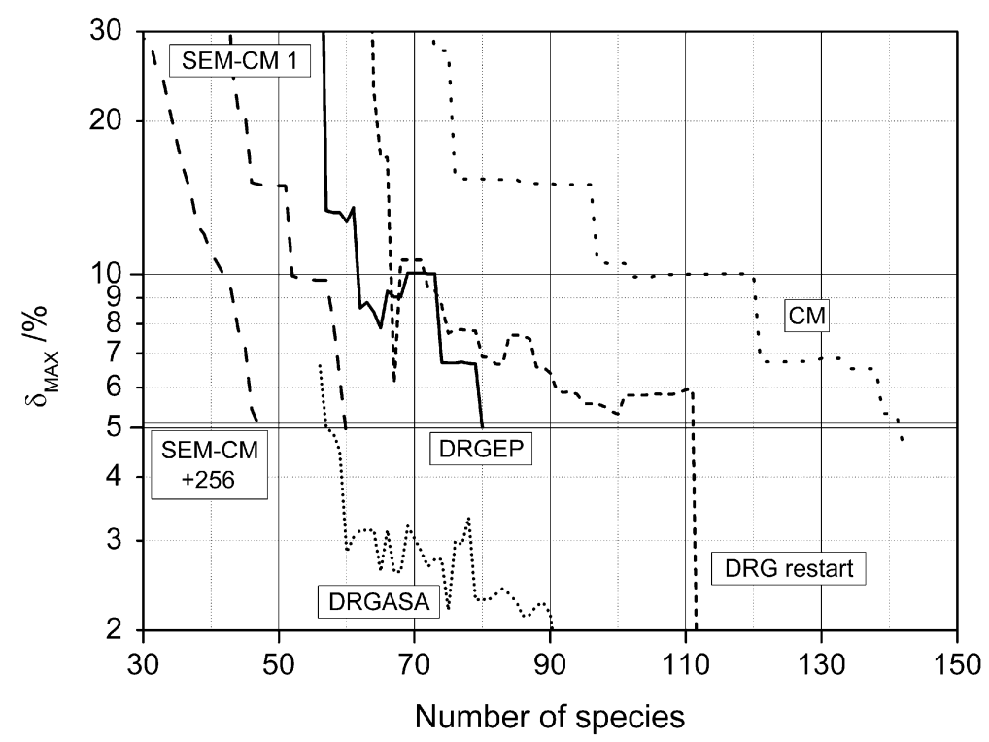
SEM case study 1: gas-phase chemistry in solid-oxide fuel cells (SOFC): partial oxidation of methane
Method time
(17 years ago!)
DRG+restart+
DRGASA
~10 min
DRGEP
~1 min
CM
~1 min
SEM-CM m=1
~12 min
SEM-CM..+256
10.5h
On a modern 16-core cpu with latest integrator codes: 10.5h → a few mins

Slide 33
SEM case study 1: gas-phase chemistry in solid-oxide fuel cells (SOFC): partial oxidation of methane
mechanism species reactions speed-up
original 345 6874 1×
CM 139 2494 6×
DRGEP 80 1172 21×
DRG+restart+DRGASA 57 821 38×
SEM-CM 47 613 58×
Simulation time is proportional to the square of the number of species
⇒ SEM-CM reduced mechanism gives fastest simulations
These mechanisms usually still contain redundant reactions:
⇒ reaction removal methods can be applied for further reduction.

Slide 34
Reaction removal 1:
The classic rate-of-production analysis (ROPA)
The contribution of each reaction step to the formation and removal of each necessary species is investigated at several time points.
measure of
contribution:
formation rates consumption rates
$$R_{α}: \text{rate} \text{of} \text{an} \text{elementary} \text{step} (\text{one}\text{−}\text{way})\text{, }\text{always} >0$$
A reaction β can be eliminated if its contribution to all species is less than a small threshold value ε at all investigated times.

Slide 35

Reaction removal 1:
The classic rate-of-production analysis (ROPA)
KINALC output
Net prod. rate= Prod. rate– Cons. rate
CH4 Rate : -1.082E-08
No Contribution # reaction
1 -1.17547E-08 34.8 %C 152 C2H3+CH4 => C2H4+CH3
2 9.13403E-09 39.8 %P 151 C2H4+CH3 => C2H3+CH4
3 -7.16821E-09 21.2 %C 140 CH≡CCH2.+CH4 => CH≡CCH3+CH3
4 -5.71162E-09 16.9 %C 136 CH2=CHCH2.+CH4 => CH2=CHCH3+CH3
5 3.72978E-09 16.2 %P 139 CH≡CCH3+CH3 => CH≡CCH2.+CH4
6 3.60756E-09 15.7 %P 135 CH2=CHCH3+CH3 => CH2=CHCH2.+CH4
7 3.45436E-09 15.0 %P 143 C2H6+CH3 => C2H5+CH4
CH3 Rate : 4.636E-10
No Contribution # reaction
1 -1.69871E-08 22.7 %C 7 2CH3 => C2H6
2 1.17547E-08 15.6 %P 152 C2H3+CH4 => C2H4+CH3
3 -9.13403E-09 12.2 %C 151 C2H4+CH3 => C2H3+CH4
4 7.84580E-09 10.4 %P 8 C2H6 => 2CH3
C2H2 Rate : 1.996E-09
No Contribution # reaction
1 6.06561E-09 44.1 %P 81 CH2=CHCH2. => C2H2+CH3
2 -5.12527E-09 43.6 %C 82 C2H2+CH3 => CH2=CHCH2.
3 3.86101E-09 28.1 %P 190 C2H3(+M) => H+C2H2(+M)
4 -3.15073E-09 26.8 %C 189 H+C2H2(+M) => C2H3(+M)
5 -1.15098E-09 9.8 %C 67 C2H2+CH3 => CH≡CCH3+H
$$rAβ\left(\%\right)>5\%$$

Slide 36
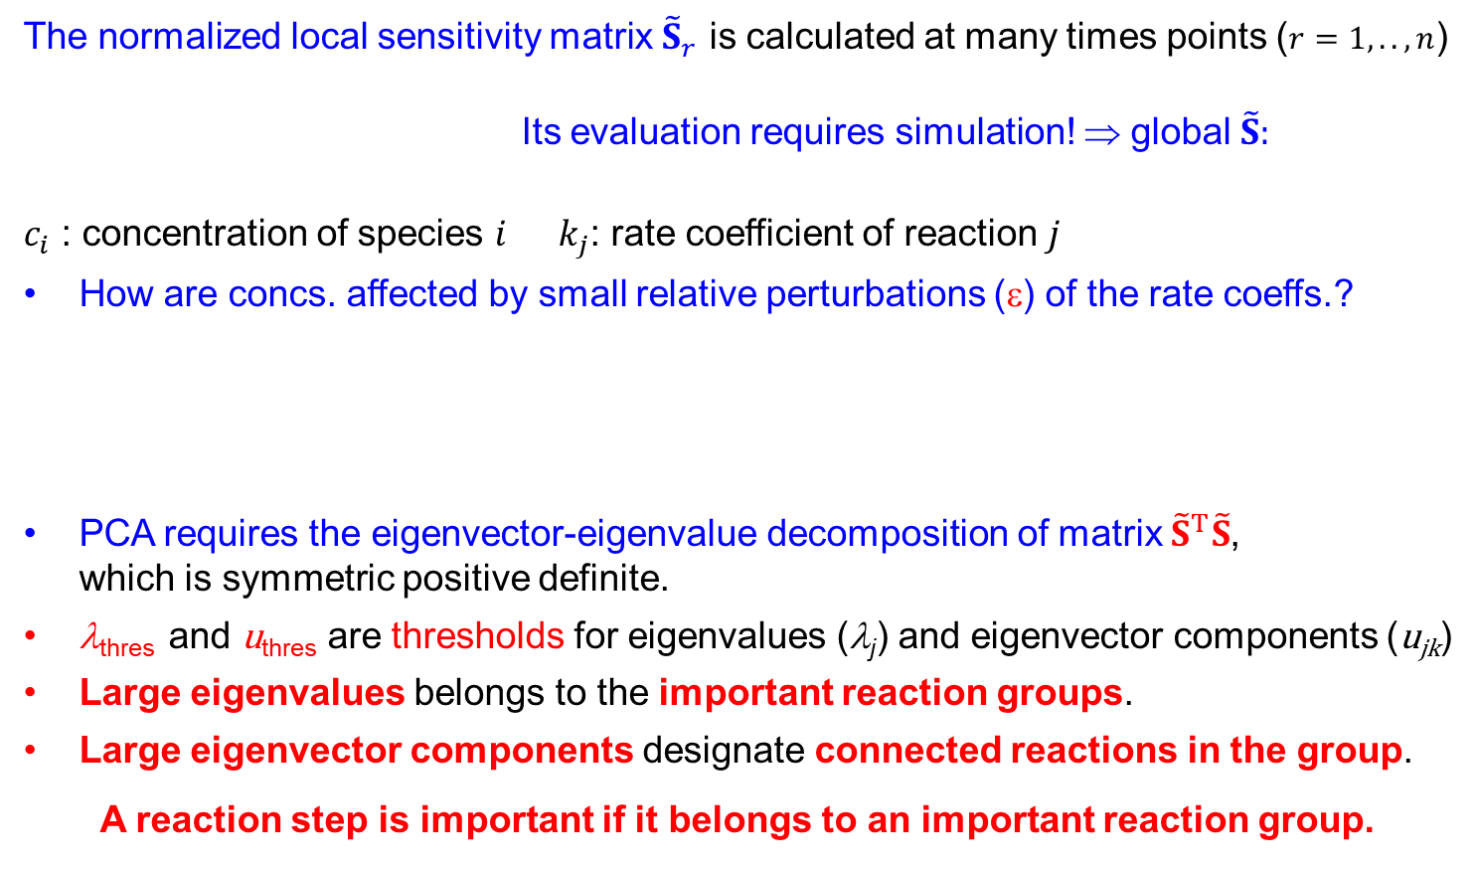
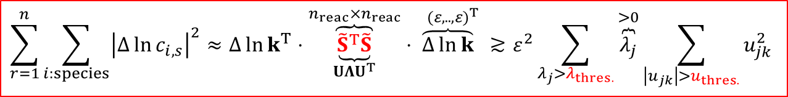

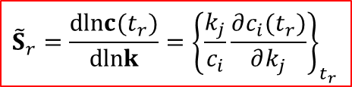
Reaction removal 2: Principal Component Analysis of the Concentration Sensitivity Matrix (PCAS)
The normalized local sensitivity matrix ${\tilde{S}}_{r}$ is calculated at many times points ($r=1,..,n$)
Its evaluation requires simulation! ⇒ global $\tilde{S}:$
$c_{i}$ : concentration of species 𝑖 $k_{j}$: rate coefficient of reaction $j$
How are concs. affected by small relative perturbations (ε) of the rate coeffs.?
PCA requires the eigenvector-eigenvalue decomposition of matrix ${\tilde{S}}^{T}\tilde{S}$,
which is symmetric positive definite.
λ_{thres} and u_{thres} are thresholds for eigenvalues (λ_{j}) and eigenvector components (u_{jk})
Large eigenvalues belongs to the important reaction groups.
Large eigenvector components designate connected reactions in the group.
A reaction step is important if it belongs to an important reaction group.
$${\tilde{S}}_{r}=\frac{d\text{ln}c(t_{r})}{d\text{ln}k}={\left\{\frac{k_{j}}{c_{i}}\frac{∂c_{i}(t_{r})}{∂k_{j}}\right\}}_{t_{r}}$$
$$\tilde{S}=\left[\begin{matrix}{\tilde{S}}_{1} \\ ⋮ \\ {\tilde{S}}_{n}\end{matrix}\right]$$
$$\sum_{r=1}^{n}{\sum_{i:species}{{\left|Δ\ln{c_{i,s}}\right|}^{2}}}≈Δ\ln{k^{T}}⋅\overset{n_{reac}×n_{reac}}{\overbrace{\underset{UΛU^{T}}{\underbrace{{\tilde{S}}^{T}\tilde{S}}}}}⋅\overset{ (ε,..,ε)^{T}}{\overbrace{Δ\ln{k}}} ≳ε^{2}\sum_{λ_{j}>λ_{thres.}}{\overset{>0}{\overbrace{λ_{j}}}\sum_{\left|u_{jk}\right|>u_{thres.}}{u_{jk}^{2}}}$$
S. Vajda, P. Valkó, T. Turányi: Principal Component Analysis of Kinetic Models
Int.J.Chem.Kinet., 17, 55-81 (1985)

Slide 37
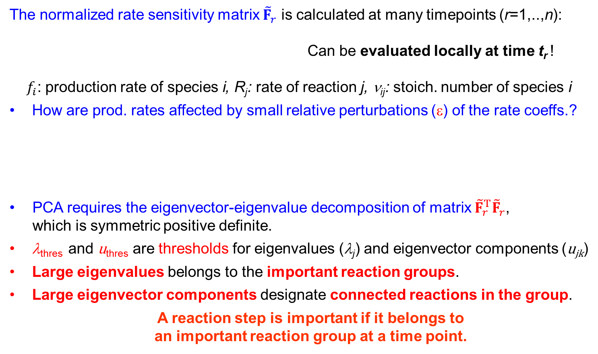
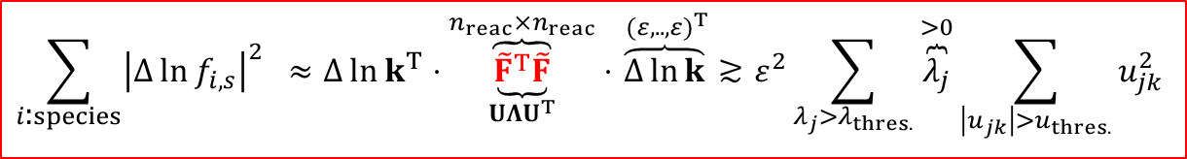
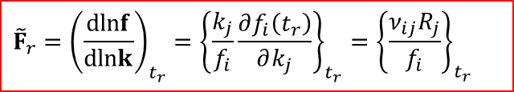
Reaction removal 3: Principal Component Analysis of the Rate Sensitivity Matrix (PCAF)
The normalized rate sensitivity matrix ${\tilde{F}}_{r}$ is calculated at many timepoints (r=1,..,n):
Can be evaluated locally at time t_{r} !
$f_{i}$: production rate of species i, R_{j}: rate of reaction j, ν_{ij}: stoich. number of species i
How are prod. rates affected by small relative perturbations (ε) of the rate coeffs.?
PCA requires the eigenvector-eigenvalue decomposition of matrix ${\tilde{F}}_{r}^{T}{\tilde{F}}_{r}$,
which is symmetric positive definite.
λ_{thres} and u_{thres} are thresholds for eigenvalues (λ_{j}) and eigenvector components (u_{jk})
Large eigenvalues belongs to the important reaction groups.
Large eigenvector components designate connected reactions in the group.
A reaction step is important if it belongs to
an important reaction group at a time point.
$${\tilde{F}}_{r}={\left(\frac{d\text{ln}f}{d\text{ln}k}\right)}_{t_{r}}={\left\{\frac{k_{j}}{f_{i}}\frac{∂f_{i}\left(t_{r}\right)}{∂k_{j}}\right\}}_{t_{r}}={\left\{\frac{ν_{ij}R_{j}}{f_{i}}\right\}}_{t_{r}}$$
$$\sum_{i\text{:}species}{{\left|Δ\ln{f_{i,s}}\right|}^{2} }≈Δ\ln{k^{T}}⋅\overset{n_{reac}×n_{reac}}{\overbrace{\underset{UΛU^{T}}{\underbrace{{\tilde{F}}^{T}\tilde{F}}}}}⋅\overset{ (ε,..,ε)^{T}}{\overbrace{Δ\ln{k}}}≳ε^{2}\sum_{λ_{j}>λ_{thres.}}{\overset{>0}{\overbrace{λ_{j}}}\sum_{\left|u_{jk}\right|>u_{thres.}}{u_{jk}^{2}}}$$
T. Turányi, T. Bérces, S. Vajda: Reaction rate analysis of complex kinetics systems
Int.J.Chem.Kinet., 21, 83-99 (1989)

Slide 38
PCAS versus PCAF
PCAS PCAF
Investigates impact on concentration functions, which depend on the history of the simulation.
Investigates the impact on reaction rates, which depend on the actual state only.
analysis for a time interval
analysis at a time point
S calculated numerically
F calculated analytically
In all investigated cases PCAS and PCAF
provided exactly the same reduced mechanisms.
PCAF is recommended as it requires only a single simulation.

Slide 39
Case study: H₂-air flame mechanism reduction
PCAS and PCAF provided identical reduced mechanisms
lines: 46-step full mechanism
dots: 25-step reduced mechanism
H₂
H₂O
mole fraction
O₂
I. Gy. Zsély, T. Turányi: The influence of thermal coupling and diffusion on the importance of reactions: The case study of hydrogen-air combustion, Phys.Chem.Chem.Phys., 5, (2003) 3622-3631

Slide 40
Reaction removal 4: PCAF with simulation error minimization (SEM-PCAF)
1. Generation of many reduced mechanisms
The simulation error does not change monotonically
with eigenvalue and eigenvector thresholds in the PCAF method.
Many reduced models are created by trying various thresholds.
2. Making the reduced mechanisms to be living
The reduced mechanisms may contain ”dead” species, whose
producing reactions are added based on F-matrix analysis.
3. Simulation of mechanisms and storing results
Simulations are carried out: errors and CPU times are recorded.
4. Finding the fastest reduced mechanism with small simulation error
Many different reduced mechanisms are similarly accurate.
The reduced mechanism which can be simulated the fastest was
selected from the accurate ones as the best one.
T. Nagy, T. Turányi: Reduction of very large reaction mechanisms using methods based on simulation error minimization, Combust. Flame, 156 (2009) 417–428

Slide 41
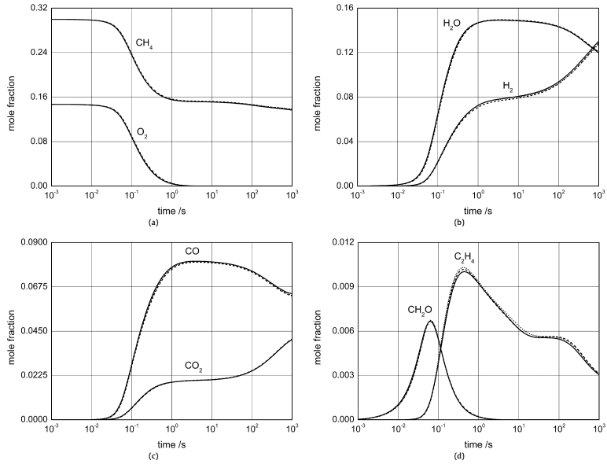
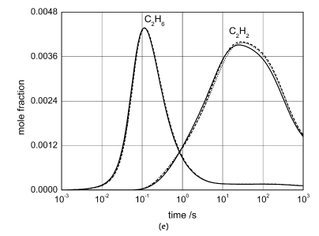
SEM case study 1: gas-phase chemistry in solid-oxide fuel cells (SOFC): partial oxidation of methane
⎯⎯⎯ original mechanism 345 species in 6874 reactions
- - - - - SEM-CM 47 species in 613 reactions 58× speed-up
⋅ ⋅ ⋅ ⋅ ⋅ ⋅ SEM-CM+SEM-PCAF 47 species in 246 reactions 116× speed-up
Simulation time reduced proportionally with the number of reactions.

Slide 42
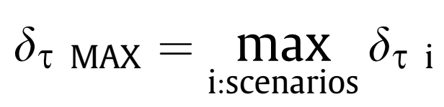
Case study 2: Reduction of the NUIG natural gas mechanism for the ignition of CH₄/C₃H₈ mixtures at gas turbine conditions
System
NUIG Natural Gas Mechanism: 229 species, 1359 reactions
22 scenarios taken from RCM and ST experiments
CH₄: C₃H₈= 9:1, ϕ(O₂) = 0.5-1.0, diluent: Ar, N₂ 38-75%
p = 7-40 atm, T = 877-1465K
Target ⇒ definition of simulation error:
max. 5% error in ignition delay times in adiabatic-isochoric simulations
SEM-CM failed to efficiently reduce error for 22 scenarios in a single run.
Hierarchical reduction strategy
Separate reduced mechanism was made for each of the 22 scenarios.
The 22 scenarios were then grouped into 6 regimes based on similarity.
For each regime, the intersection of species lists was determined.
Using these, a reduced mechanism was developed for all 6 regimes.
Finally, starting from their unified list a global reduced model was developed.
Gy. I. Zsély, T. Nagy, J.M. Simmie, H.J. Curran : Reduction of a detailed kinetic model for the ignition of methane/propane mixtures at gas turbine conditions using simulation error minimization methods, Combust. Flame, 158, 1469–1479 (2011)

Slide 43
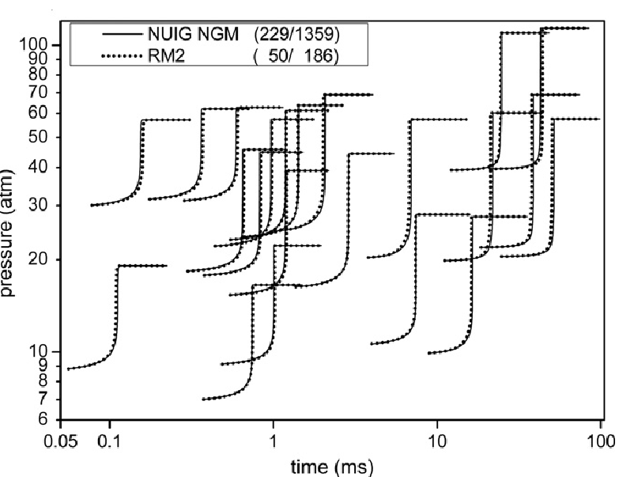
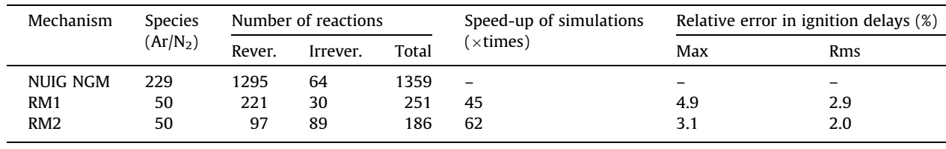
Case study 2: Reduction of the NUIG natural gas mechanism for the ignition of CH₄/C₃H₈ mixtures at gas turbine conditions
RM1
Mechanism after species removal
with SEM-CM
RM2
Mechanism after
reaction removal
with SEM-PCAF
43

Slide 44
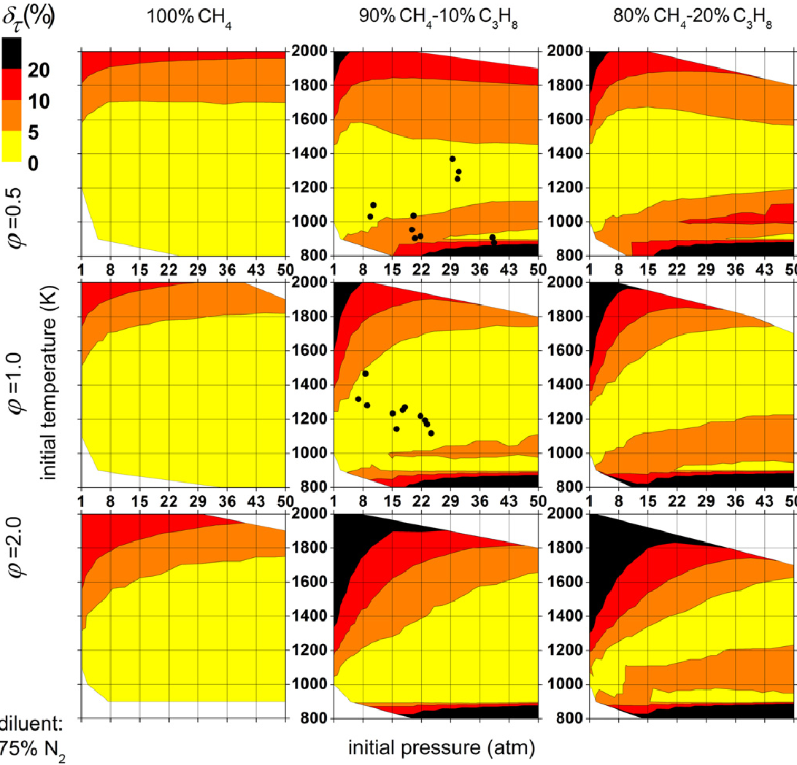
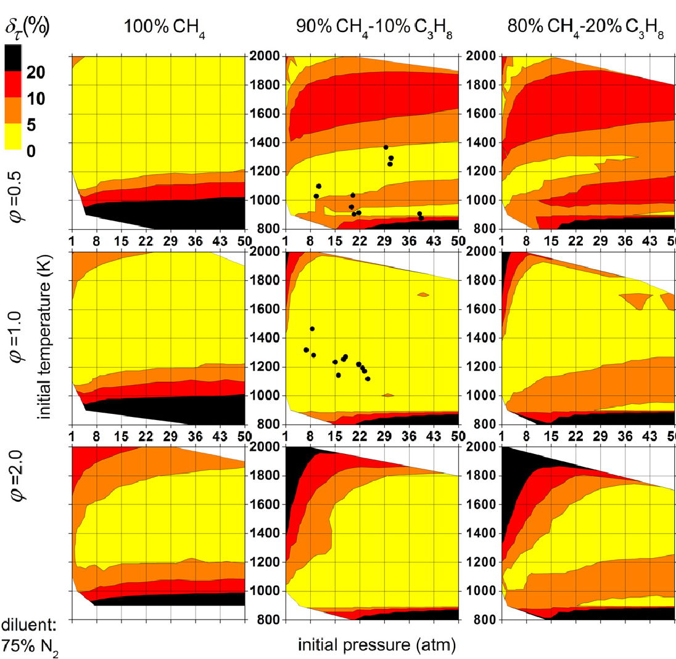
SEM case study 2: Reduction of the NUIG natural gas mech’s for the ignition of CH₄/C₃H₈ mixtures at gas turbine conditions
Robustness analysis
At what range of conditions can the reduced mechanism can reproduce the simulation result of the original mechanism
RM1
RM2
Reaction removal reduced robustness.
Accurate in a much wider range.
44

Slide 45
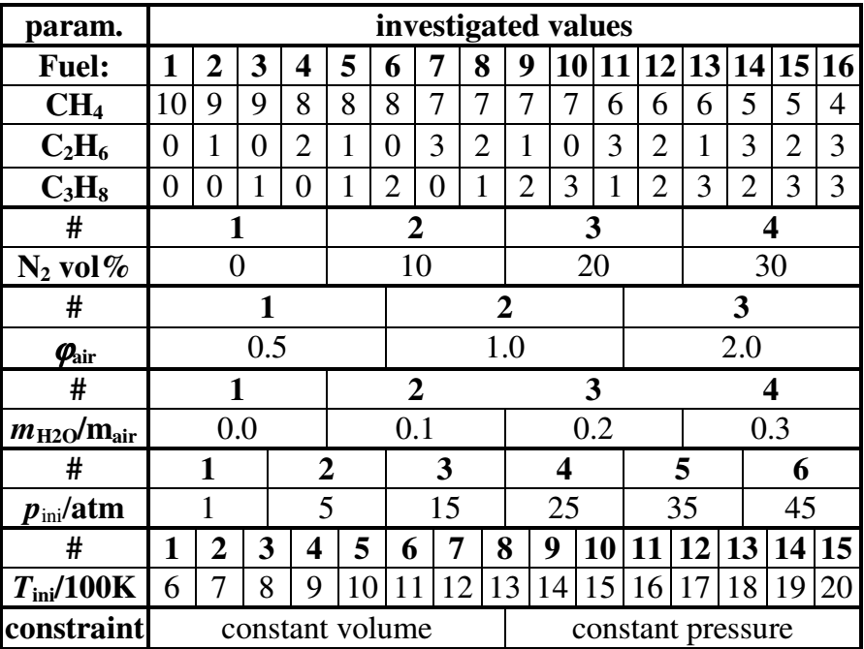
SEM case study 3: Reduction of the NUIG natural gas mech’s for the ignition of CH₄/C₂H₆/C₃H₈ mixtures at gas turbine conditions
NUIG NGM: 228 species/1359 reactions
Target: reproduction of temperature profiles during ignition
for 40,243 relevant conditions (out of 138,240).
Matrix of conditions:
  Problem:
  SEM cannot be used
  efficiently for such
  a large number
  of conditions!
T. Nagy, I. Gy. Zsély, H.J. Curran : Reduction of a detailed kinetic model for the ignition of methane/ethane/propane mixtures at gas turbine conditions using simulation error minimization methods, Proceedings of the European Combustion Meeting (2011)
45

Slide 46
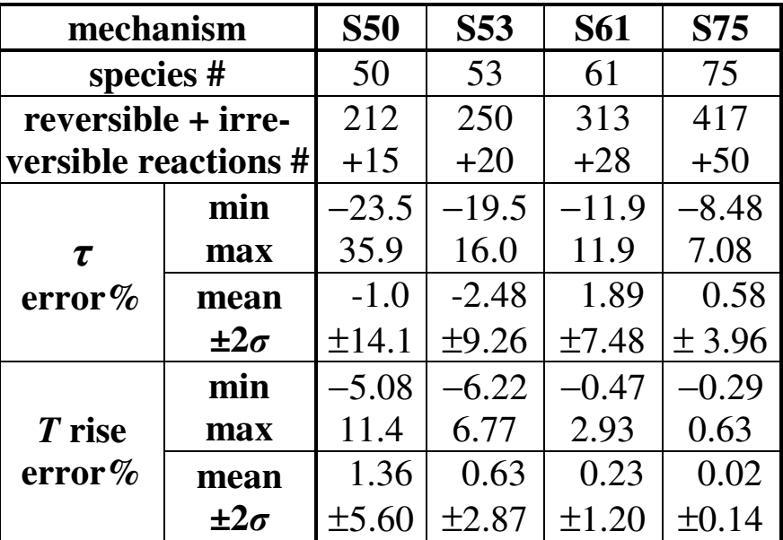
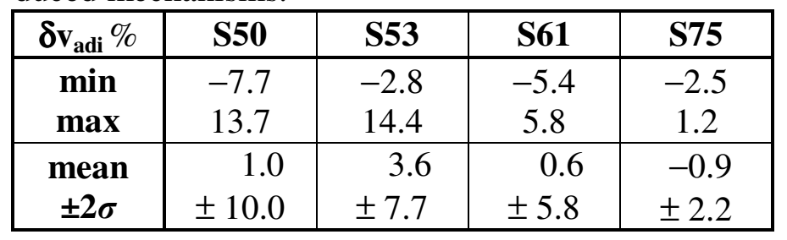
SEM case study 3: Reduction of the NUIG natural gas mech’s for the ignition of CH₄/C₂H₆/C₃H₈ mixtures at gas turbine conditions
Identifying low-number of representative (”worst-case”) scenarios:
Accurate reduced mechanism was made for three extreme scenarios.
The reduced mechanism was tested on all 40,243 scenarios.
A scenario with the largest error was selected.
Accurate reduced mechanism was made for all selected the scenarios.
Steps 2-4 were repeated until the mechanism became globaly accurate.
25 scenarios were identified
4 reduced mechanisms was developed by SEM-CM.
They were tested in 58 adiabatic laminar flame simulations.
τ error %: rel. error of ignition delay time, δv_{adi}%: rel. error of adia. flame speed
46

Slide 47


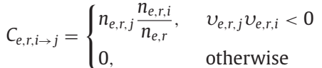



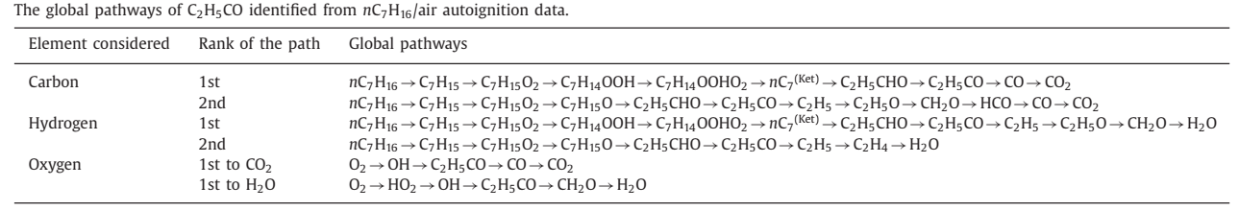
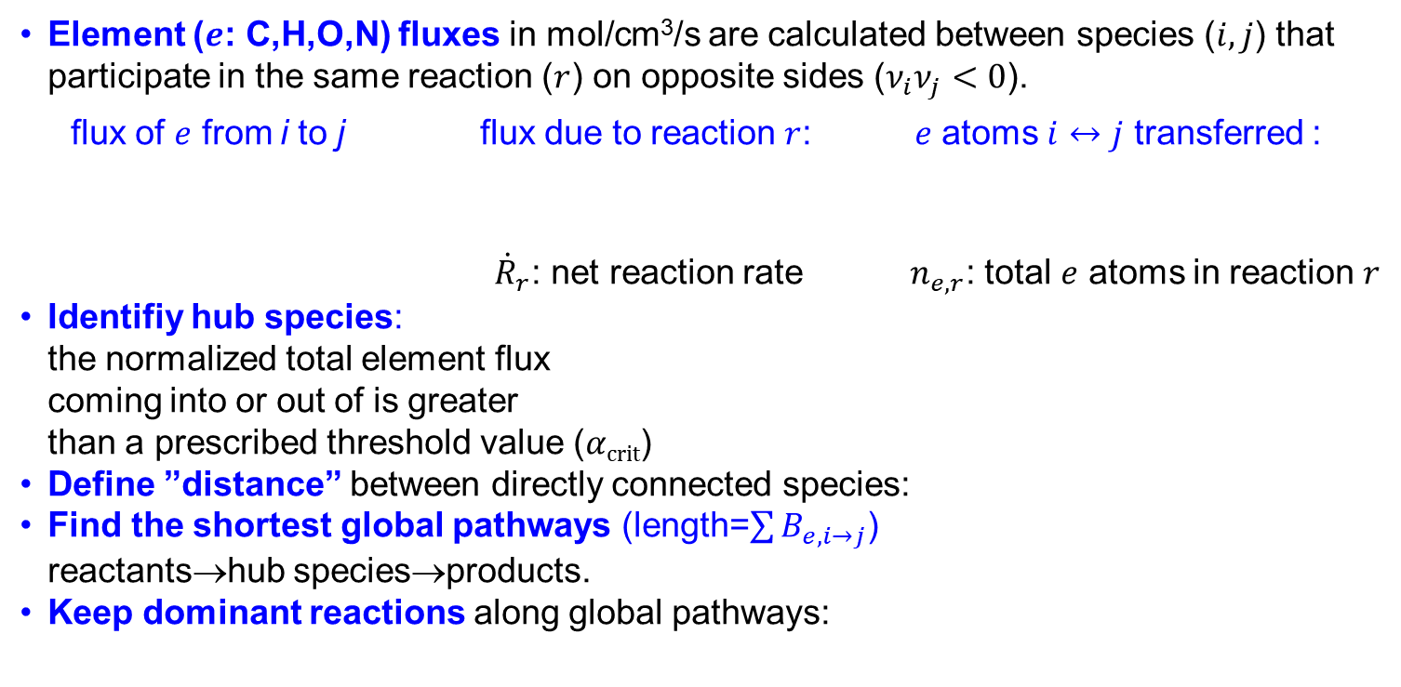
Species Removal 7: Global Pathway Selection (GPS)
Element ($e$: C,H,O,N) fluxes in mol/cm³/s are calculated between species ($i,j$) that participate in the same reaction ($r$) on opposite sides ($ν_{i}ν_{j}<0$).
flux of $e$ from i to j flux due to reaction $r$: $e$ atoms $i↔j$ transferred :
${\dot{R}}_{r}$: net reaction rate $n_{e,r}$: total $e$ atoms in reaction $r$
Identifiy hub species:
the normalized total element flux
coming into or out of is greater
than a prescribed threshold value ($αcrit$)
Define ”distance” between directly connected species:
Find the shortest global pathways (length=$\sum{B_{e,i→j}}$)
reactants→hub species→products.
Keep dominant reactions along global pathways:
It gives better
models than PFA
and also reveals
main pathways!
X. Gao, S. Yang, W. Sun: A global pathway selection algorithm for the reduction of detailed chemical kientic mechanisms Combust. Flame 167 (2016) 238-247.

Slide 48
Summary for static skeletal reduction methods
Static (a priori) skeletal reduction methods
Species + additional reaction removal: former gives larger speed-up!
Simulation time scales with the square of N_{species}, and linearly with N_{reaction}.
Measure for species connectivity in species removal methods:
  Production rate derivative (kinetic Jacobi element): CM, SEM-CM
  Species form./cons. ratio based: DRG, DRGEP, PFA
  Element flux based: GPS
Building blocks of the reduced model:
  Species: CM, DRG, DRGEP, PFA
  Species/species groups, pathways: SEM-CM (builds formation pathways)
  Global pathways: GPS
Role of simulation error:
  Validation, stopping criterion: CM, DRG, DRGEP, PFA, GPS
  +guides the reduction: SEM-CM, „ASA” extensions to DRG/DRGEP/PFA
Recommended methods: DRGEP/PFA+ASA+PCAF, GPS methods, CSP and for not too large problems: SEM-CM+SEM-PCAF
(if full mech.<500 spec., reduced mech. <100 spec.)
SEM methods can be used to fine-tune a reduced mechanism
by identifying further species and reactions whose removal has minimal impact
on the error due to error cancellations.
Reduced models are also useful for training ML-based models.

Slide 49
Availability of reduction codes
Python-based Model Automatic Reduction Software (pyMARS)
DRG, DRGEP, PFA + all ASA combination
Uses Cantera for simulations
Free: https://github.com/Niemeyer-Research-Group/pyMARS
Ansys Chemkin-Pro Reaction Workbench
PCAS, DRG, DRGEP, PFA, DRG-ASA, DRGEP-ASA, Isomer Lumping
Uses Chemkin Pro for simulations
Commercial !: https://www.ansys.com/products/fluids/ansys-chemkin
KINALC (CM, ROPA, PCAS, PCAF)
CHEMKIN II-III, CHEMKIN 4 outputs, Free: https://respecth.elte.hu/
Simulation Error Minimization (SEM-CM, SEM-PCAF)
Old version uses its own integrator: only closed homogeneous reactors
Free: https://respecth.elte.hu/
In preparation: Optima++ based version to use any integrator and reactor type
Global Pathway Selection (GPS)
Uses Cantera for simulations
Free: https://github.com/golsun/GPS
Computational Singular Perturbation (CSP)
Very powerful method for mechanism reduction based on time-scale separation.
See Professor Goussis’ talk on CSP!

